Slide 1
Routing basics 2
Hardeep Kaur Dhalla

Slide 2
Objectives
Nesting of routes
Guards
Observables

Slide 3
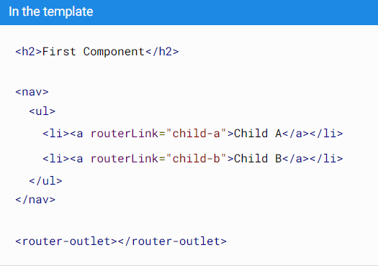
Nesting routes
You can also add child routes which are relative to a component other than the root component.
You will need to use <router-outlet> directive.

Slide 4
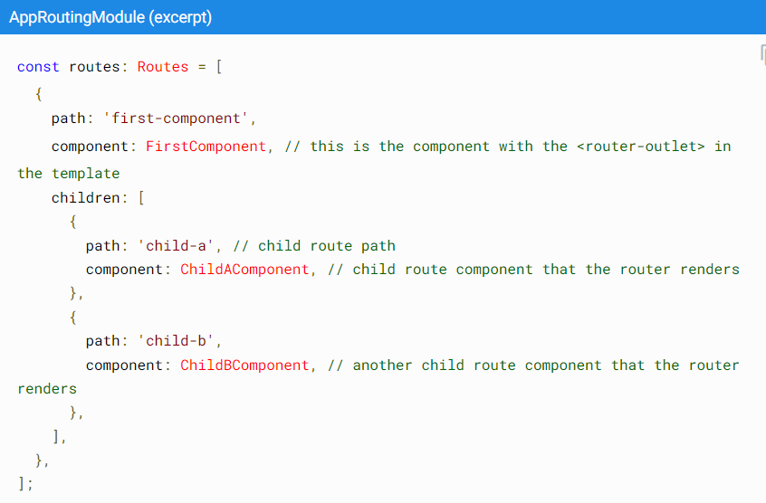

Slide 5
Route guards in angular
Use route guards to prevent users from navigating to parts of an application without authorization.
The following route guards are available in Angular:
CanActivate
CanActivateChild
CanDeactivate
Resolve - https://angular.io/api/router/Resolve#description
CanLoad - https://angular.io/api/router/CanLoad

Slide 6
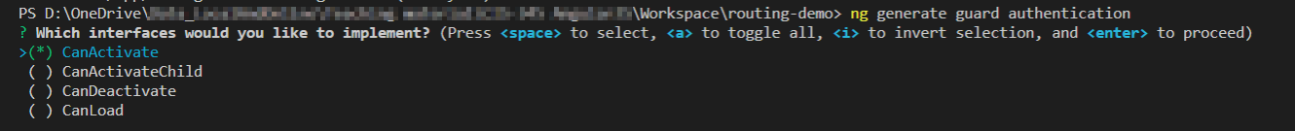
Service for a guard
Create a service for your guard:

Slide 7
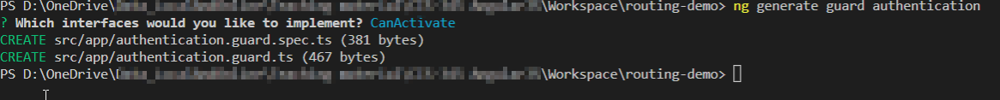
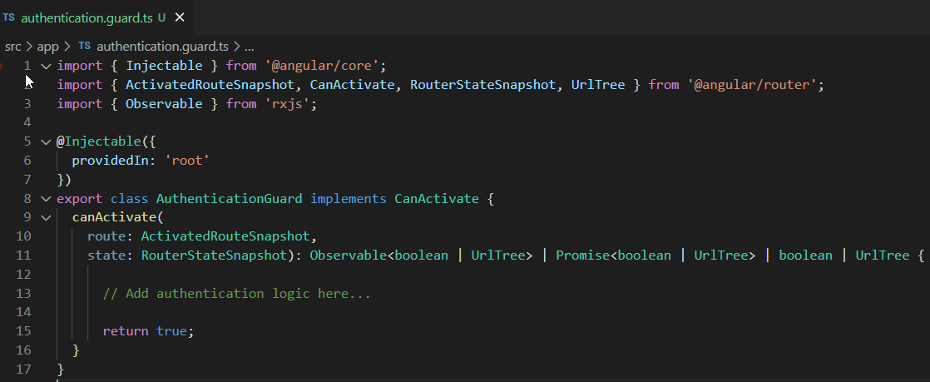

Slide 8
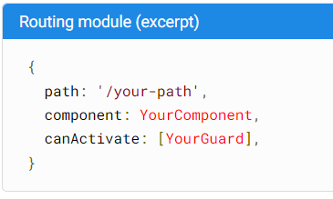
Last step
Update routing module file.

Slide 9
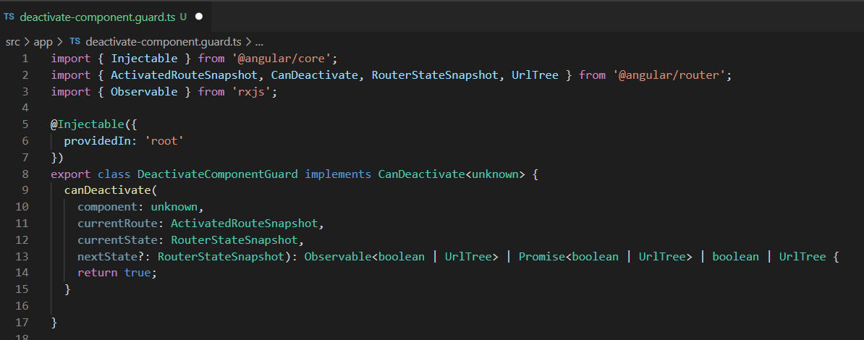
CanDeactivate interface

Slide 10
Observables
The observer pattern is a software design pattern in which an object, called the subject, maintains a list of its dependents, called observers, and notifies them automatically of state changes.
This pattern is similar (but not identical) to the publish/subscribe design pattern.
They are used frequently in Angular and are a technique for event handling, asynchronous programming, and handling multiple values.

Slide 11
How it works?
An Observable instance begins publishing values only when someone subscribes to it.
You subscribe by calling the subscribe() method of the instance, passing an observer object to receive the notifications.

Slide 12
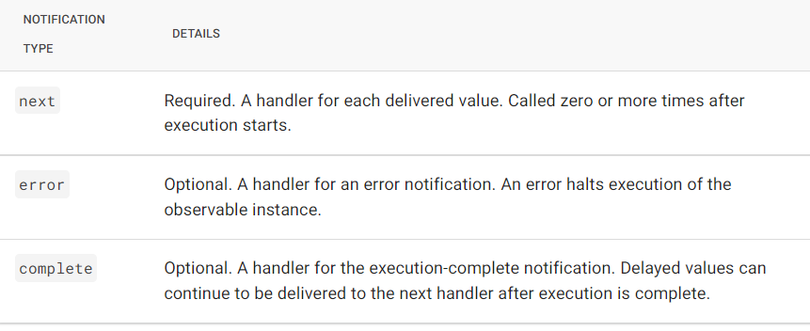
Observables
an observable can send 3 types of notifications:

Slide 13
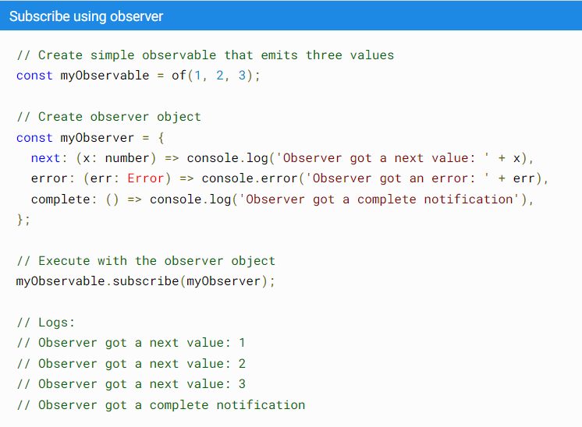
RXJS library METHOD

Slide 14
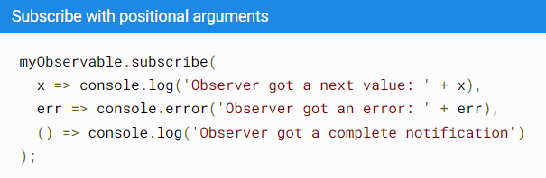
Observables
Alternatively, the subscribe() method can accept callback function definitions in line, for next, error, and complete handlers. For example, the following subscribe() call is the same as the one that specifies the predefined observer:

Slide 15
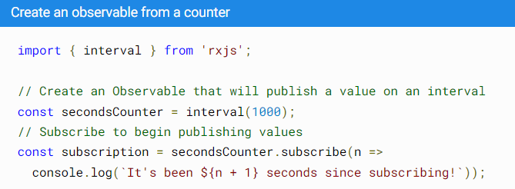
The RxJS library
https://rxjs.dev/guide/overview
The RxJS (Reactive Extensions for JavaScript) is a 3rd party library that we can use in angular for reactive programming.
We can work with data streams using observables.
The library also provides utility functions for creating and working with observables.

Slide 16
The RxJS library
EventEmitter extends RxJSSubject
https://angular.io/api/core/EventEmitter#subscribe
Angular's HttpClient returns observables from HTTP method calls. For instance, http.get('/api') returns an observable.
Router class, ActivatedRoute class also makes use of observables to get information about a route path and parameters etc.
Reactive forms have properties that use observables to monitor form control values.
The FormControl properties valueChanges and statusChanges contain observables that raise change events.

Slide 17
References
https://angular.io/guide/router-tutorial-toh#canactivate-requiring-authentication

